Slide 1

SUPPLY CHAIN PROJECT

Slide 2

Supply Chain Project Stages:- 1- Data Understanding (Understand what each column represent). 2- Data Loading. 3- Data Exploration (Overview about the data). 4- Data Cleaning. 5- Feature Engineering. 6- Data Analysis. 7-Data Preprocessing.

Slide 3
1- Data Understanding (Understand what each column represent). -Understand the structure of the dataset. -Import necessary analysis and processing libraries. 2- Data Loading. -Load the file DataCoSupplyChainDataset.csv.
.

Slide 4
3-Data Exploration -Inspecting the structure of the dataset using: df.info() to display data types and the number of non-missing values. df.dtypes to identify the type of each column (numerical / categorical). -Understanding dataset size: df.shape to get the number of rows and columns. -Previewing sample data: df.head() to display the first 5 rows. -Listing column names: df.columns to retrieve all column names.

Slide 5
-Descriptive data analysis: df.describe(include='number') for descriptive statistics of numerical data. df.describe(include='object') for categorical data. -Analyzing column uniqueness: df.nunique() to count the number of unique values in each column. Checking for duplicates: df.duplicated().sum() to count the number of duplicate rows. -Checking for missing values: df.isnull().sum() to get the number of missing values in each column. df.isnull().mean() * 100 to calculate the percentage of missing values.

Slide 6
4-Data Cleaning. - Drop Duplicate Rows. - Handle Missing Values. - In-depth Check for Numerical Columns. - Handle Outliers. - Clean String Columns. - Standardize Column Names. - Remove Placeholder Values. - In-depth Check for Categorical Columns. - Remove Irrelevant Columns. - Reset the index after cleaning.

Slide 7
Summary of Actions Taken During the Cleaning Removing Duplicates: - Removed duplicate rows from the dataset using df.drop_duplicates(). Handling Missing Values: - Calculated the percentage of missing values for each column. - Deleted rows with missing values in columns with less than 5% missing data. - Fill missing values if percentage between 5% and 40% - Deleted columns with more than 40% missing values.

Slide 8
In-depth Check for Numerical Columns: - Identified numerical columns using df.select_dtypes(). - Plotted histograms for each numerical column using Plotly. - Displayed summary statistics using .describe(). - Counted unique values in numerical columns. - Checked for negative values in numerical columns. - Visualized distributions using boxplots (top 6 numerical columns) with Seaborn and Matplotlib.

Slide 9
Handling Outliers: - Selected only numerical columns (int64, float64). - Printed number of rows before cleaning. - Removed outliers using IQR (Interquartile Range) method: (Filtered values within [Q1 - 1.5×IQR, Q3 + 1.5×IQR]). -Printed number of rows after outlier removal. String Cleanup -Removed extra spaces and converted values to lowercase in columns like:Customer City, Order Status, Category Name, etc.

Slide 10
Standardize Column Names -Cleaned column names:-Replaced spaces with underscores _&Removed brackets (). Remove Placeholder Values: -Defined placeholder strings such as 'xxxxxxx', 'unknown', 'n/a', 'none’. -Replaced them with NaN. -Dropped rows with placeholder values in sensitive fields like Customer_Email and Customer_Password.

Slide 11
In-depth Check for Categorical Columns: - Displayed top 3 most frequent categories for each categorical column. - Counted unique values and listed them for each column. - Calculated dominant category ratio (max frequency percentage) per column. Removing Irrelevant Columns: - Deleted columns such as)Customer_Id, Product_Image, Order_Item_Id, Product_Description, etc(. Because they are either not useful for analysis or contain identifier information. Redefine Numerical Columns after Cleaning: -Re-selected numerical columns after cleaning. - Replotted final histograms to validate data after removing outliers and irrelevant columns.

Slide 12
5-FEATURE ENGINEERING:- -DOMAIN KNOWLEDGE FEATURES. -DATE AND TIME FEATURES. -PRICING & VALUE FLAGS. -STRING FEATURES. -GEOSPATIAL FEATURES.

Slide 13
Summary of Actions Taken During FEATURE ENGINEERING:- Domain Knowledge Features --Is_Profitable_Order: Flag for orders with profit > 0. --Is_Zero_Profit: Flag for zero-profit orders. --Order_Item_Profit_Ratio: Profit to total item cost ratio. --Profit_Margin: Alias for Order_Item_Profit_Ratio. --Profitability_Category: Categorized profit margin into Loss, Low, Medium, High. --Low_Profit_High_Sales: Flag for high sales but low profit orders. --Order_Value_Category: Binned orders by total value (Low, Medium, High, Very High).

Slide 14
Domain Knowledge Features --Customer_Segment: Categorized customers by spending level. --Order_Quarter: Extracted quarter from order date. --Profit_Category: Classified profit ratio into low, medium, or high. --Order_Type: Flagged as premium if price > 1000 and discount < 100, otherwise regular. Date & Time Features --Order_Year, Order_Month, Order_Weekday: Extracted year, month, and weekday from order date. --Order_Weekend: Flag for weekend orders. --Shipping_Duration: Calculated shipping time in days.

Slide 15
Pricing & Value Features --Price_After_Discount: Subtracted discount from product price. --Discount_Level: Binned discount rate into No Discount, Low, Medium, High. --Is_High_Value_Order: Flag for products priced above 500. --Total_Discount: Calculated total discount value for quantity. --Unit_Revenue: Calculated revenue per order line. --Total_Units_Ordered: Tracked quantity ordered. --Avg_Price_per_Unit: Calculated average unit price. --Has_Discount: Flag for items that received any discount.

Slide 16
String-Based Features: --Customer_FullName: Combined first and last name. --Customer_Location: Combined city and country. --Customer_Name_Tokens: Counted number of words in full name. --Product_Name_WordCount: Counted words in product name. Geospatial Features: --Country_Group: Grouped countries into regions: North America, Europe, Asia, Other. --Is_Major_City: Flag for key cities like New York, London, Dubai, etc.

Slide 17
Data Analysis
Univariate
Bivariate
Multivariate

Slide 18
6-Data Analysis Analytical Questions. Univariate Analysis – Insights: Calculated: Overall column means. Calculated: Overall column medians. Calculated: standard deviation of each numerical column.

Slide 19
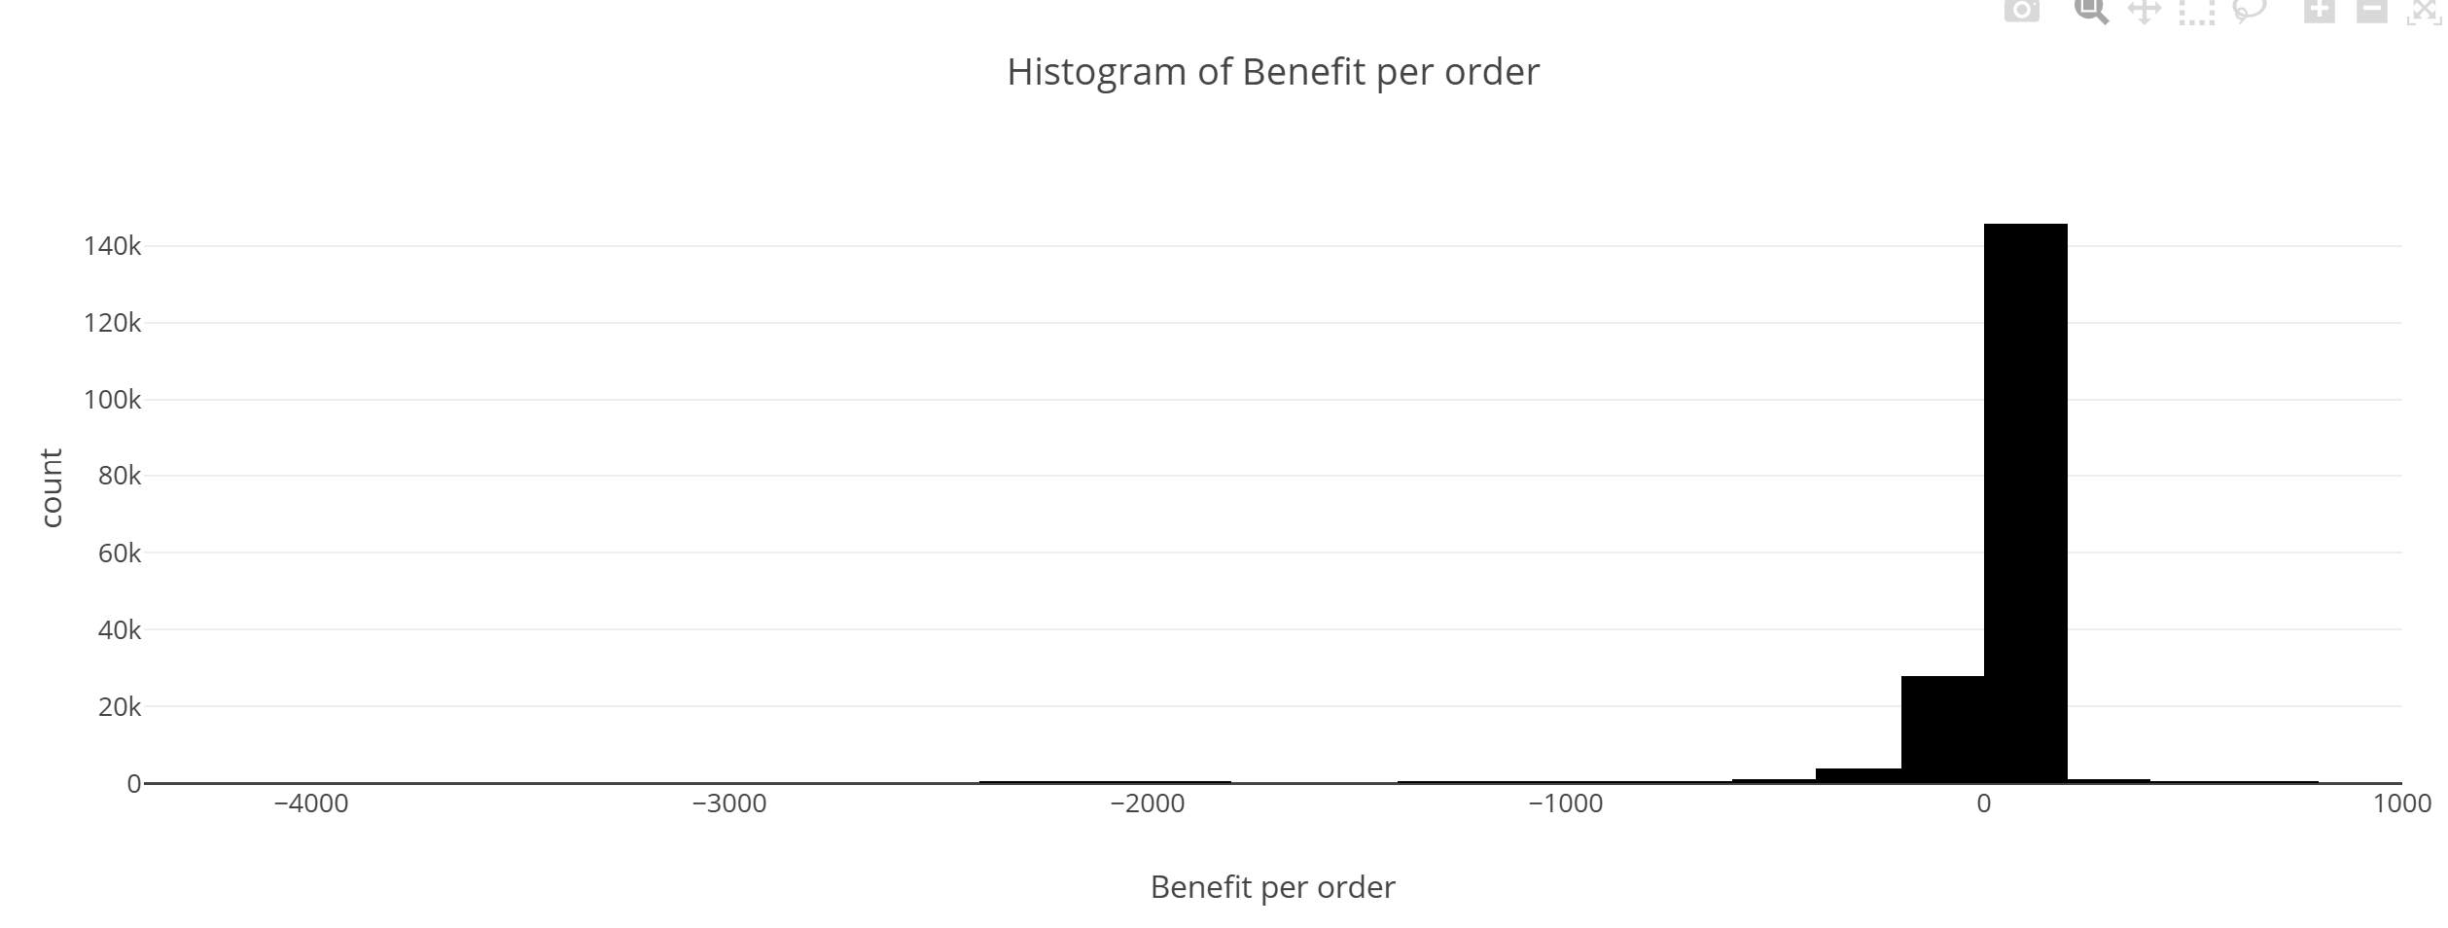
What is the distribution of Benefit per Order? Plotted histogram with KDE using Seaborn. Displayed statistical summary with .describe().

Slide 20
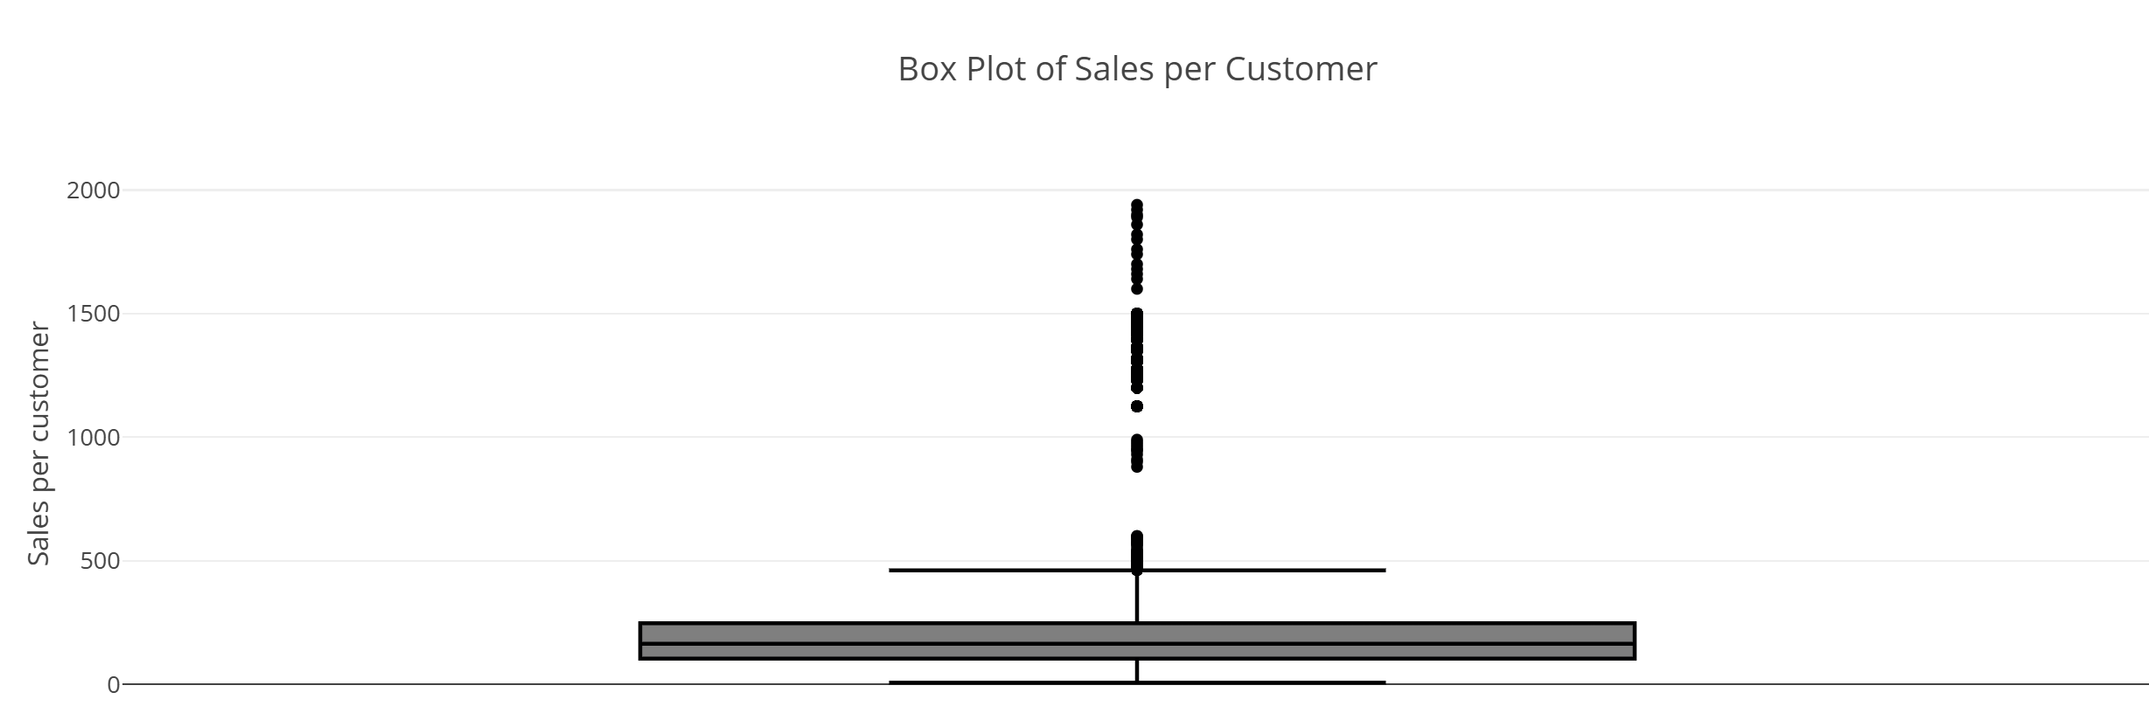
What is the distribution of Sales per Customer? Histogram with KDE to visualize frequency. Box plot created using Plotly to detect outliers and spread. Descriptive statistics displayed.

Slide 21
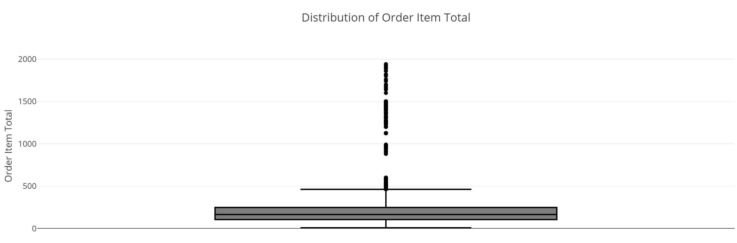
What is the distribution of Order Item Total? Used box plot (Plotly) to examine value spread. Summarized with .describe().

Slide 22
What is the distribution of Order Item Profit? Histogram (Seaborn) with KDE for profit spread analysis. What is the distribution of Order Item Profit Ratio? Histogram with KDE showing the ratio between profit and item total.

Slide 23
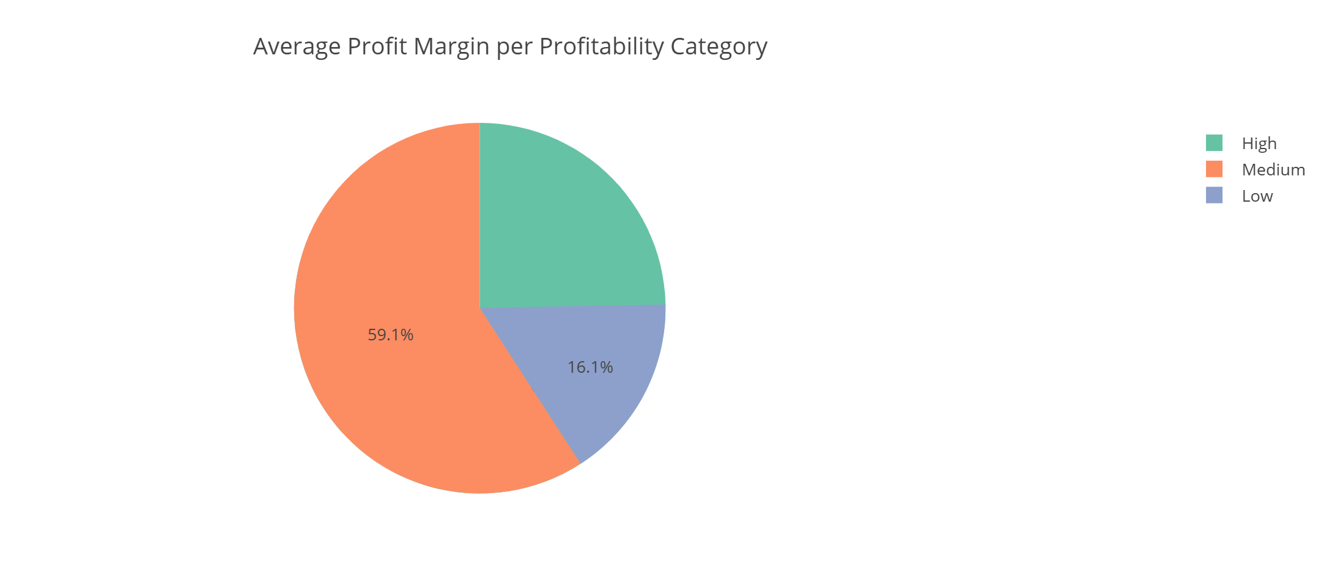
What is the average profit margin for each Profitability Category? Grouped data by Profitability_Category. Calculated mean profit margin. Visualized using a pie chart with Plotly.

Slide 24
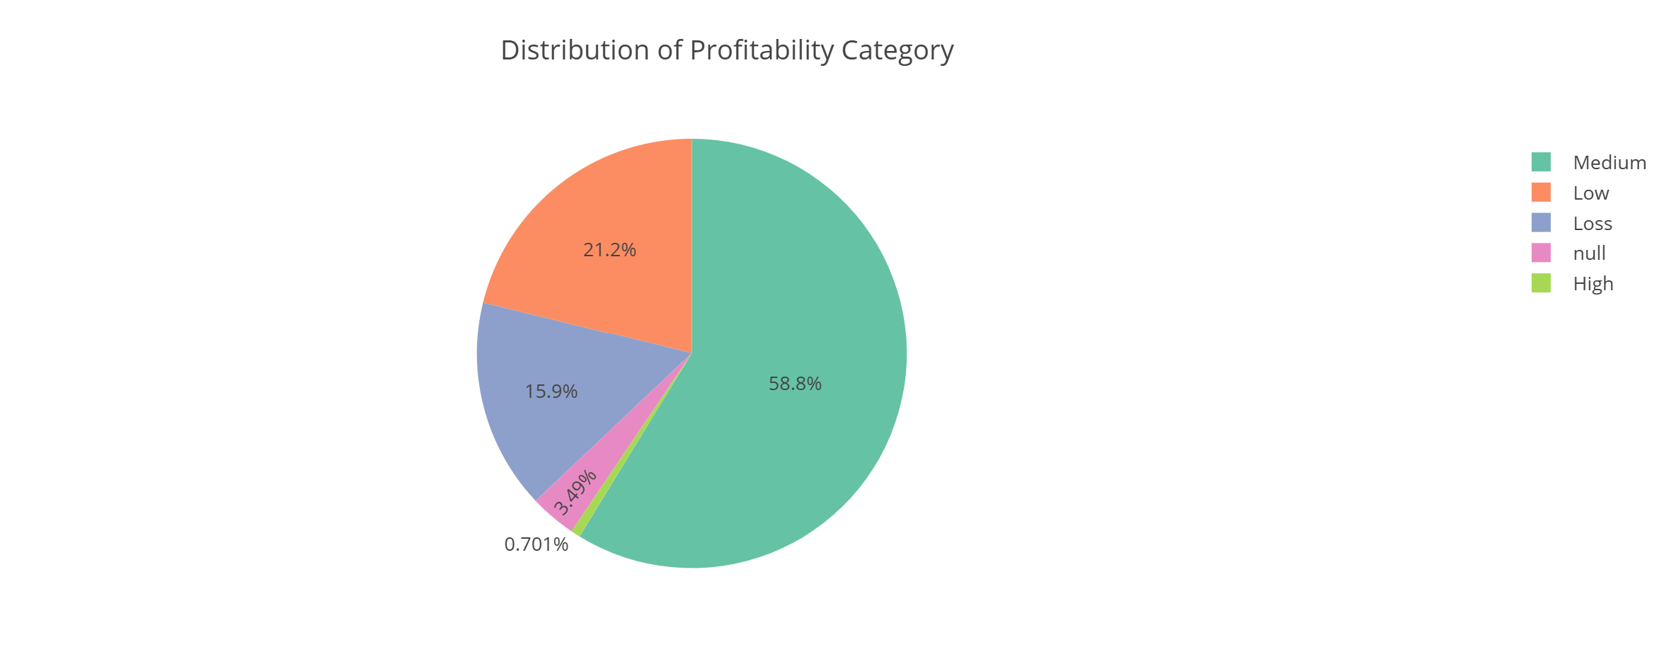
How are orders spread across Profitability Levels? Pie chart displaying proportions for each profitability category.

Slide 25
How are Profit Margins spread across orders? Box plot to visualize distribution and outliers in Profit_Margin. What is the distribution of Order Item Discount Rate? Used histogram (Seaborn) with KDE. What is the distribution of Shipping Delay? Histogram showing spread of shipping delays. What is the distribution of Shipping Duration? Histogram (Seaborn) with KDE to visualize number of shipping days.

Slide 26
What is the distribution of Late Delivery Risk? Histogram to assess how frequently late delivery occurs. How are customers divided into Segments? Pie chart showing distribution of Customer_Segment. What is the most common Request Type? Bar chart showing frequency of each Type value. What are the most common categories in Order Status? Bar chart showing counts per status category (with rotation for clarity). .

Slide 27
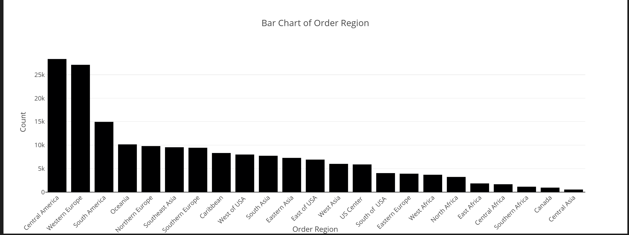
What are the most common categories in Order Region? Bar chart showing region frequency in the dataset.

Slide 28
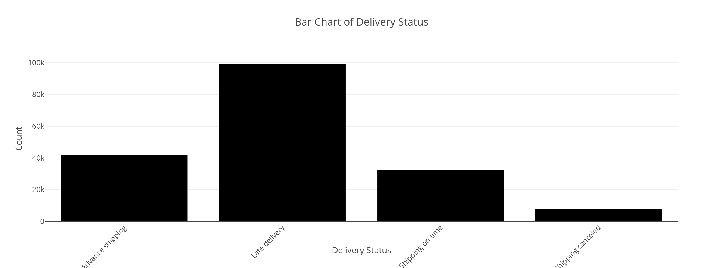
What are the most common categories in 'Delivery Status’? A bar chart was used to display the frequency distribution of delivery status values. The chart helps identify which delivery statuses occur most often in the dataset. X-axis shows delivery status categories, Y-axis shows count of occurrences.

Slide 29
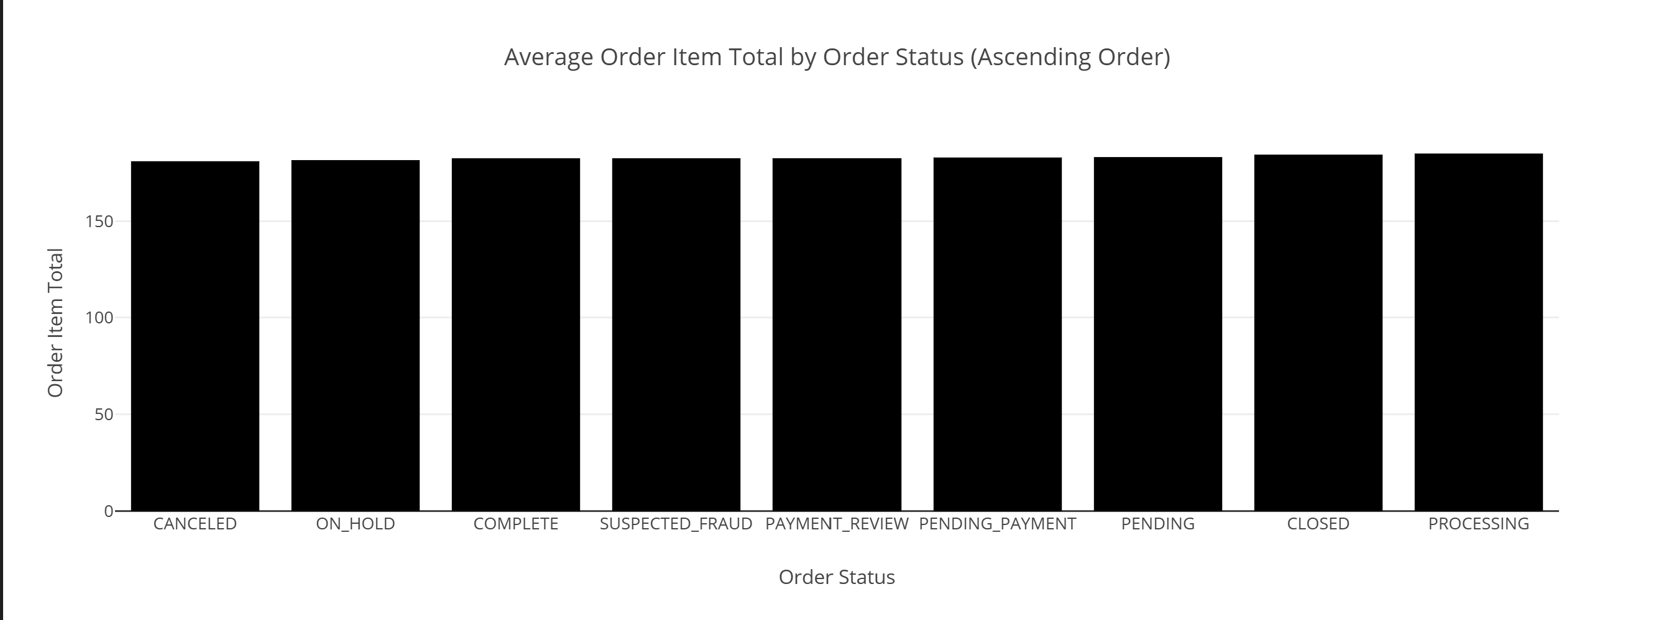
Bivariate Analysis – Insights: calculated mean 'Order Item Total' for each 'Order Status'? What is the average (mean) Order Item Total for each Order Status?

Slide 30
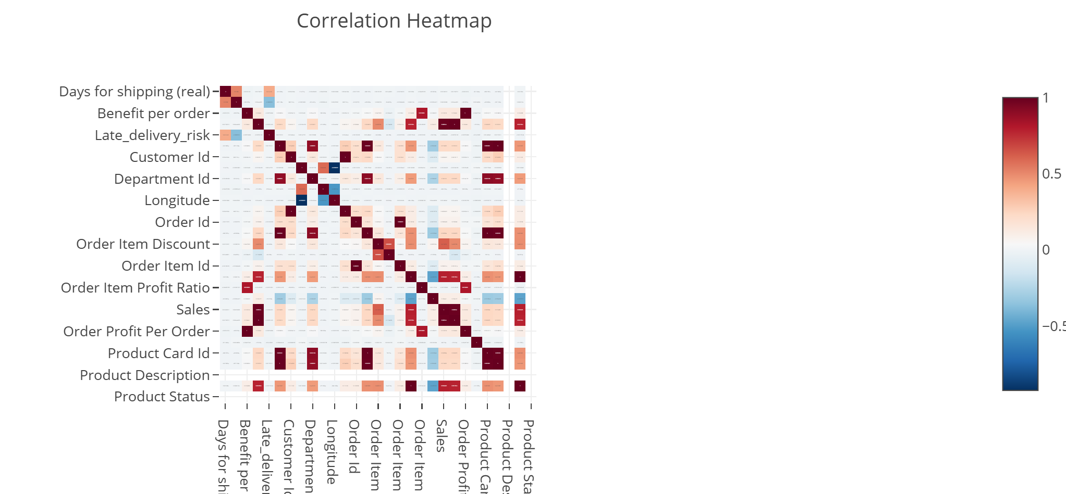
What is the correlation among all numerical variables? A heatmap was used to visualize correlation between all numerical columns using Pearson’s method. Color scheme: coolwarm, with annotation enabled.

Slide 31
What is the relationship between Sales per Customer and Profit Margin? A scatter plot was used to show the correlation and trend between these two numerical variables. How does Profit Margin vary across Profitability Categories? Box plot was used to compare the distribution of profit margins for each category (Low, Medium, High). How does Sales per Customer vary by Customer Segment? Box plot to show how customer segments impact their spending behavior. How does Order Item Total differ by Order Status? Violin plot to compare the distribution and spread of totals across different order statuses.

Slide 32
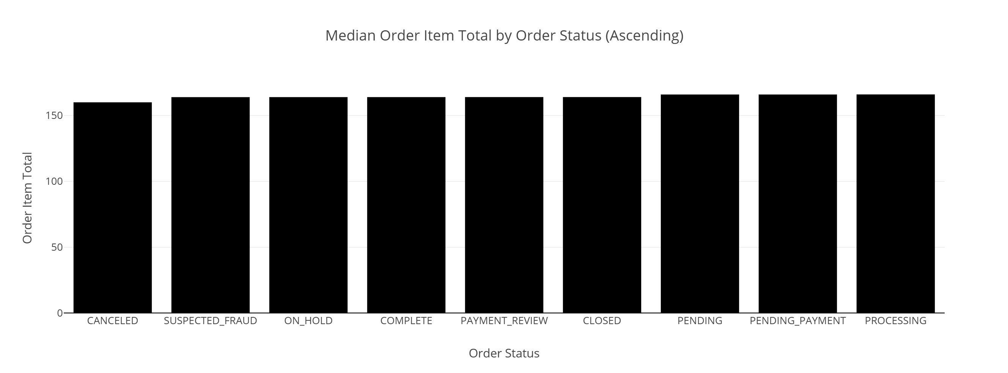
What is the median Order Item Total for each Order Status?

Slide 33
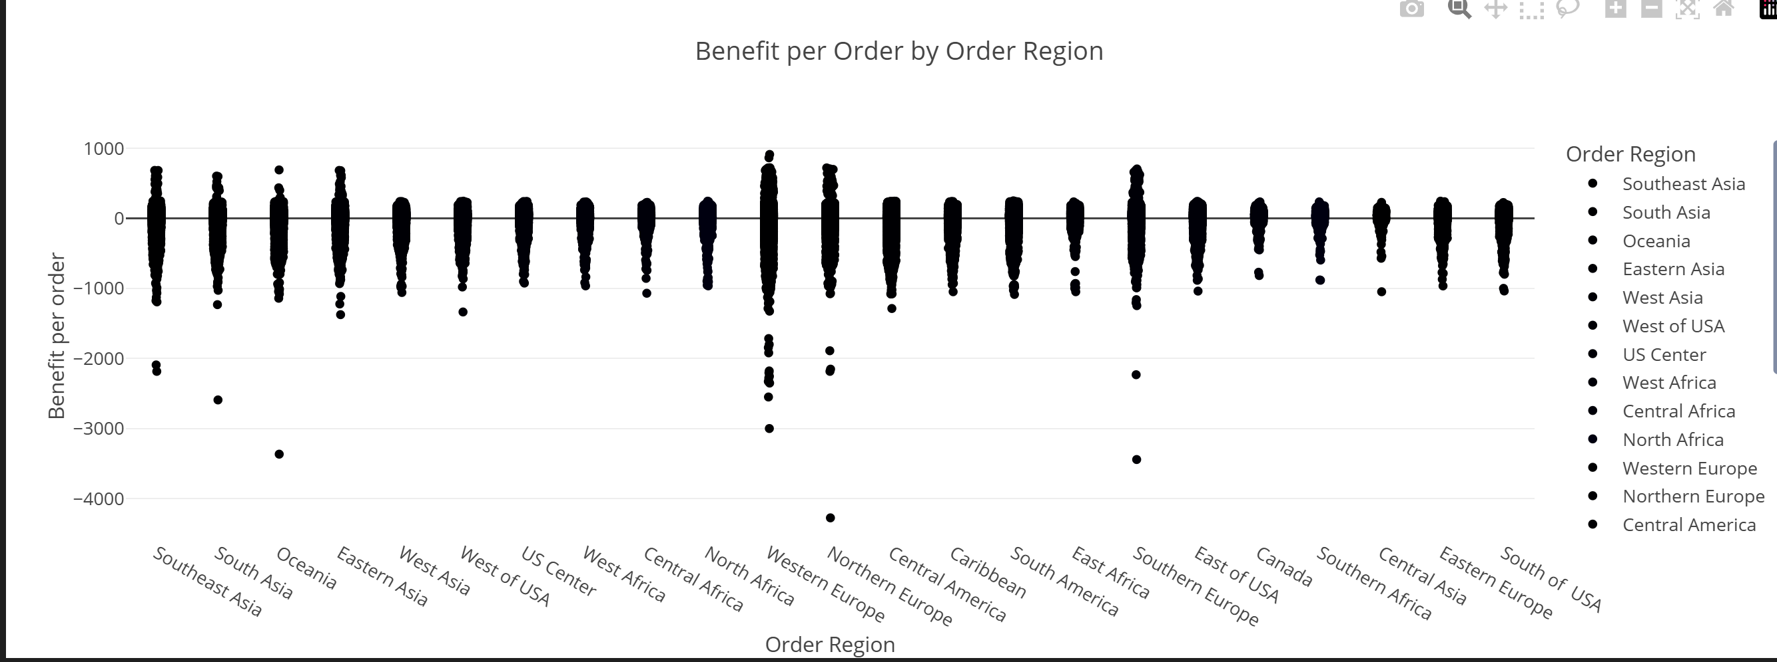
What is the distribution of Benefit per Order by Order Region? Strip plot used to observe benefit distribution across geographic regions.

Slide 34
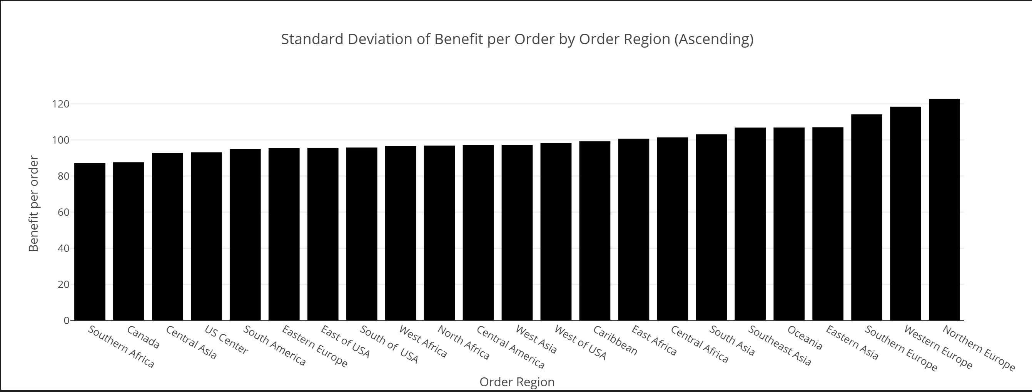
What is the standard deviation of Benefit per Order across different Order Regions?

Slide 35
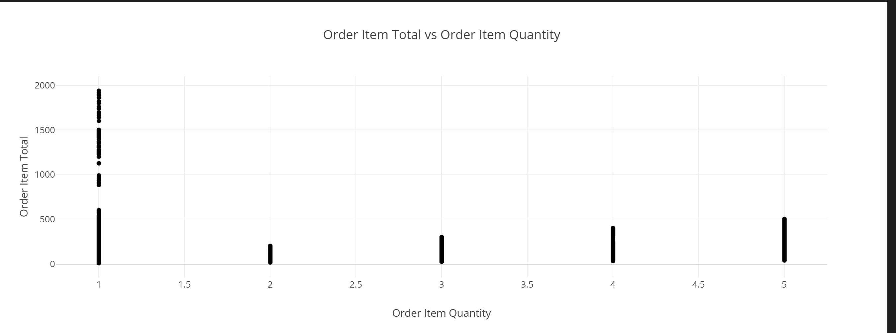
Does Order Item Quantity increase with Order Item Total? Scatter plot used to examine the positive or negative correlation between quantity and total cost.

Slide 36
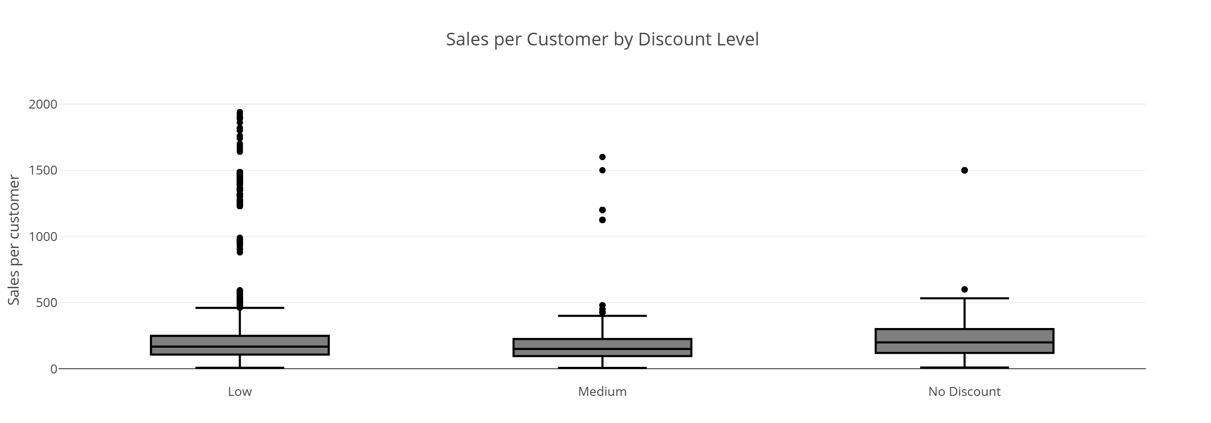
How does Discount Level affect Sales per Customer? Box plot grouped by discount level (Low, Medium, High) and sales amount

Slide 37
Does Discount Rate affect Profit Ratio? Scatter plot showing relationship between discount rate and profit ratio. Is Profit Ratio consistent across Regions? Violin plot used to observe variations in profit ratio by region. What is the variation of Benefit per Order by Customer Segment? Strip plot shows how customer segmentation impacts benefit received.

Slide 38
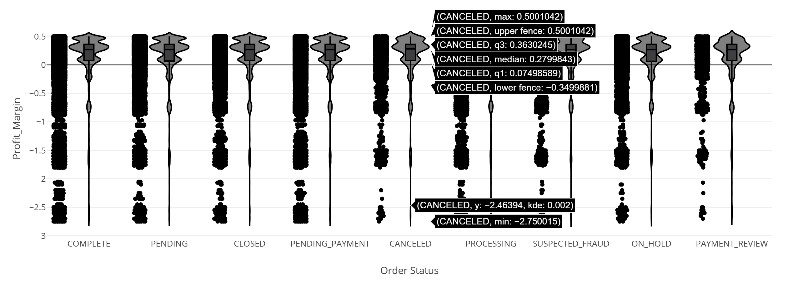
Do different Order Statuses impact Profit Margin? Violin plot used to show spread of profit margins across statuses.

Slide 39
How does Order Item Quantity differ across Product Categories? Box plot comparing quantity ordered across different category names. How does Profit Margin change over Order Item Total? Line plot showing how profit margin evolves as the total item cost increases. Are high-value orders always more profitable? Box plot comparing order profit for each value category (Low, Medium, High, Very High).

Slide 40
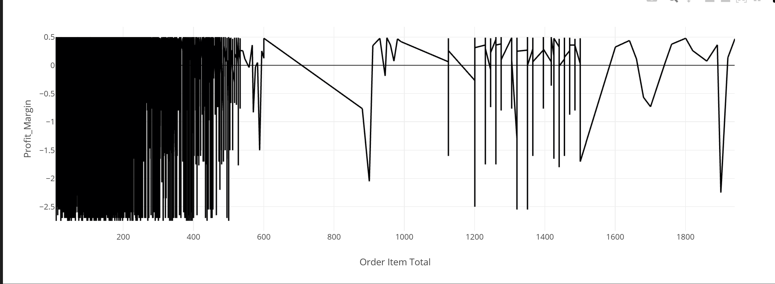
How does Profit Margin change over Order Item Total? Line plot showing how profit margin evolves as the total item cost increases.

Slide 41
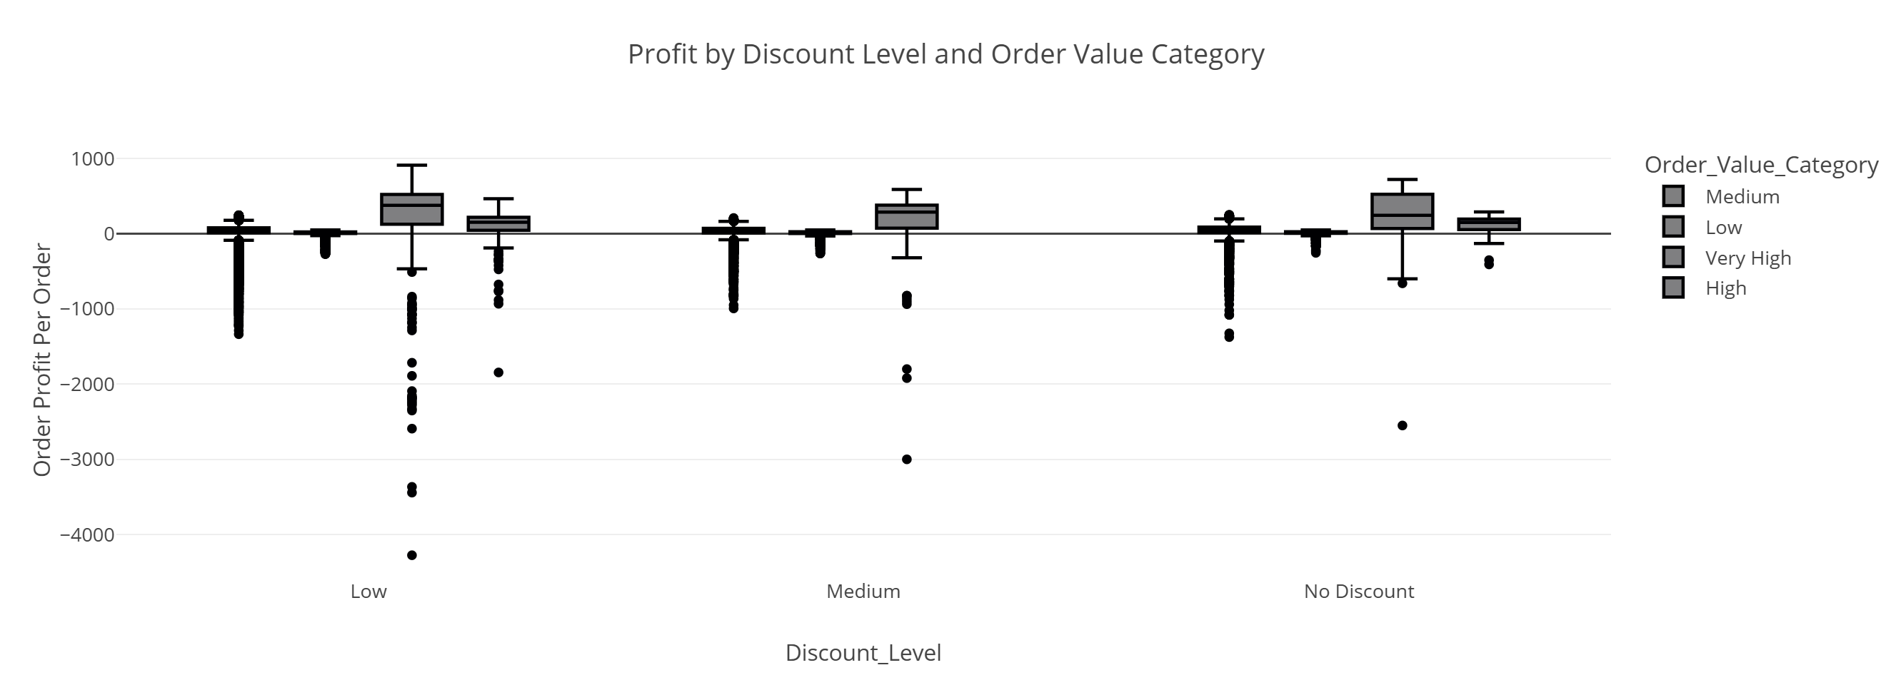
Multivariate Analysis :- Analyze how Discount Level, Order Value Category, and Profit interact? Used sns.catplot() with x=Discount_Level, y=Order_Item_Profit, and hue=Order_Value_Category.

Slide 42
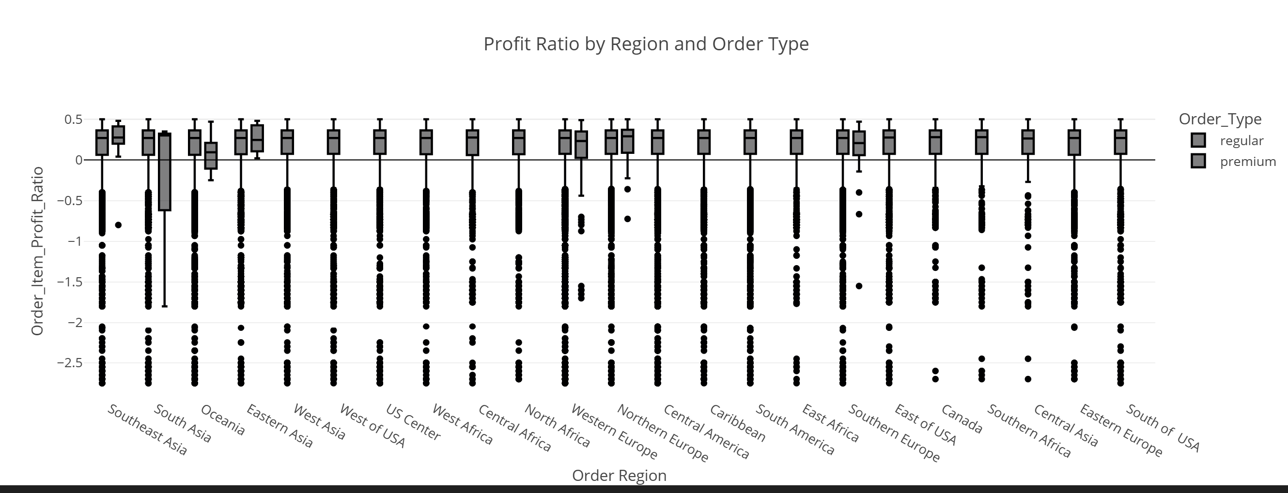
Examine the influence of Region and Order Type on Profit Ratio? Used sns.boxplot() with x=Order Region, y=Order_Item_Profit_Ratio, and hue=Order_Type.

Slide 43
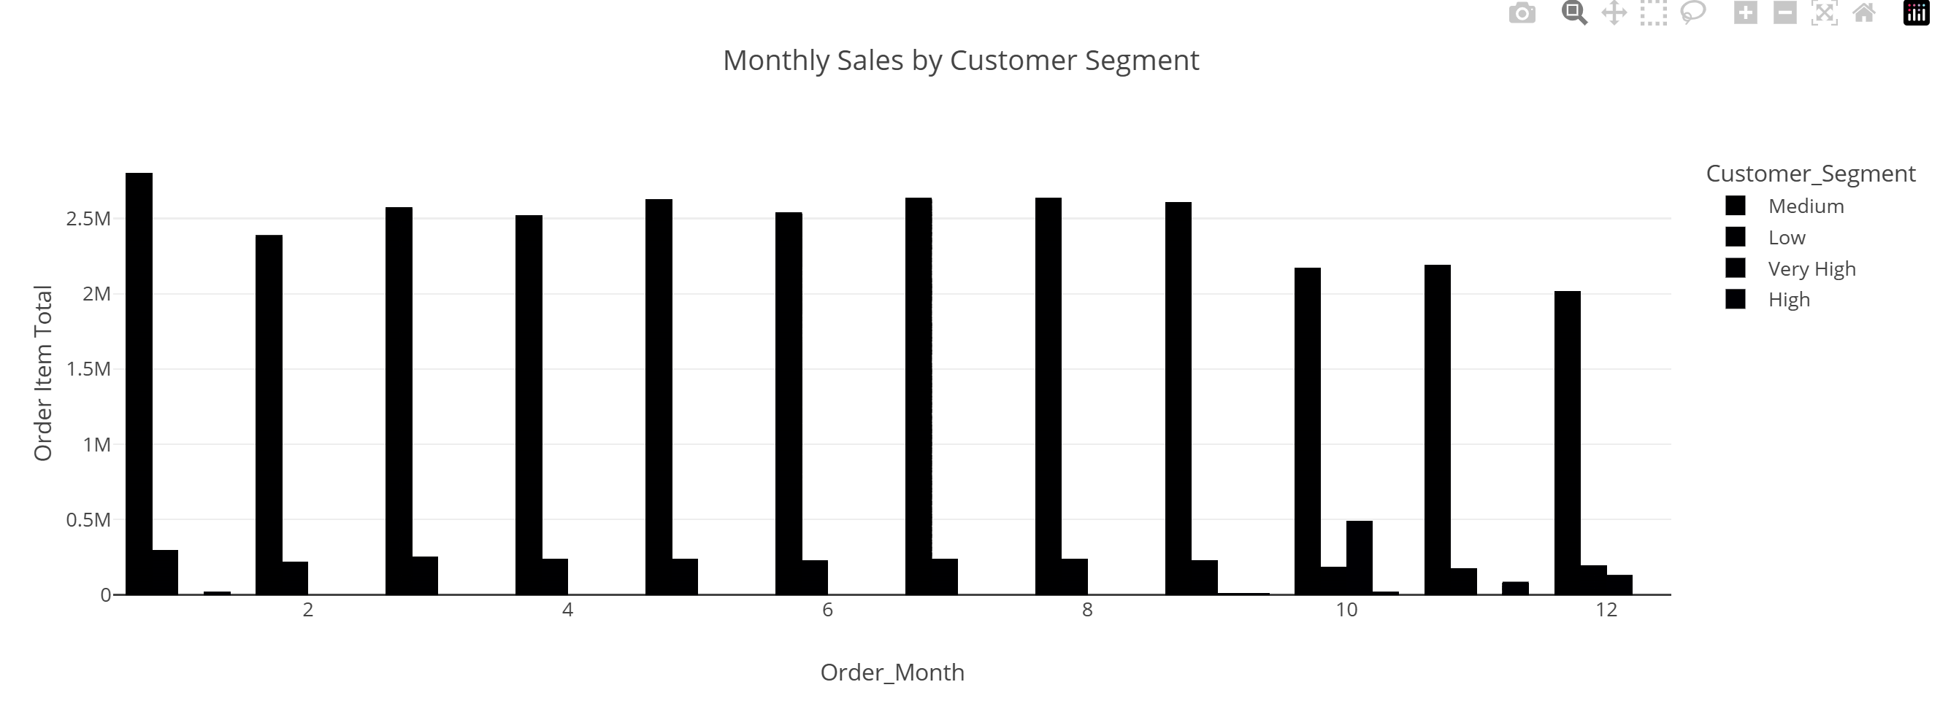
Study how Monthly Sales differ by Customer Segment? Used sns.barplot() with x=Order_Month, y=Order_Item_Total, and hue=Customer_Segment, aggregated using sum.

Slide 44
7-Data Preprocessing:- Step1. Split Data into Input Features and Target Variable. Step2. Split Data into Train and Test. Step3. Initial Data Inspection Step4. Nominal Encoding Step5. Binary Encoding Step6. Data Visualization Step7. Impute Missing Step8. Numerical Scaling Step9. Handle Class Imbalance Step10. Model Training Step11. Model Evaluation

Slide 45
Step 1: Split Input Features and Target:- -Extract input X by dropping the Late_delivery_risk column. -Set target variable y = df['Late_delivery_risk’]. Step 2: Train/Test Split -Use train_test_split() with test_size=0.3 and random_state=42 to split data.

Slide 46
Step 3: Initial Data Inspection Printed shape of x_train and y_train Displayed first 10 rows of x_train4. Step 4:Nominal Encoding Applied One-Hot Encoding on 'Order Status' column using OneHotEncoder. Step 5: Binary Encoding Applied Binary Encoding on 'Customer State' column using BinaryEncoder.

Slide 47
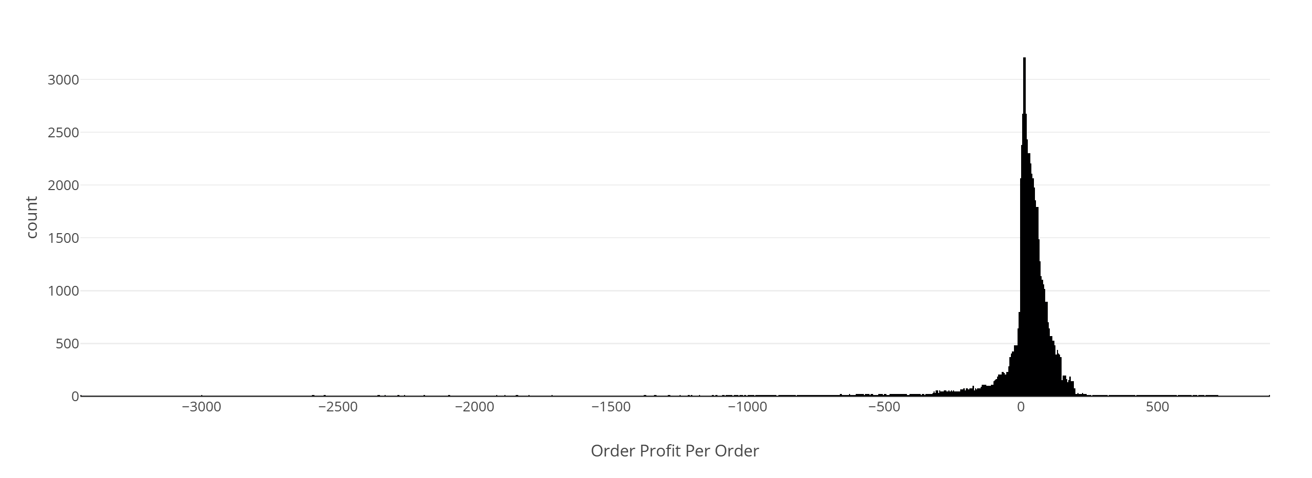
Step 6: Data Visualization Created a histogram for 'Order Profit Per Order ' column using plotly.express

Slide 48
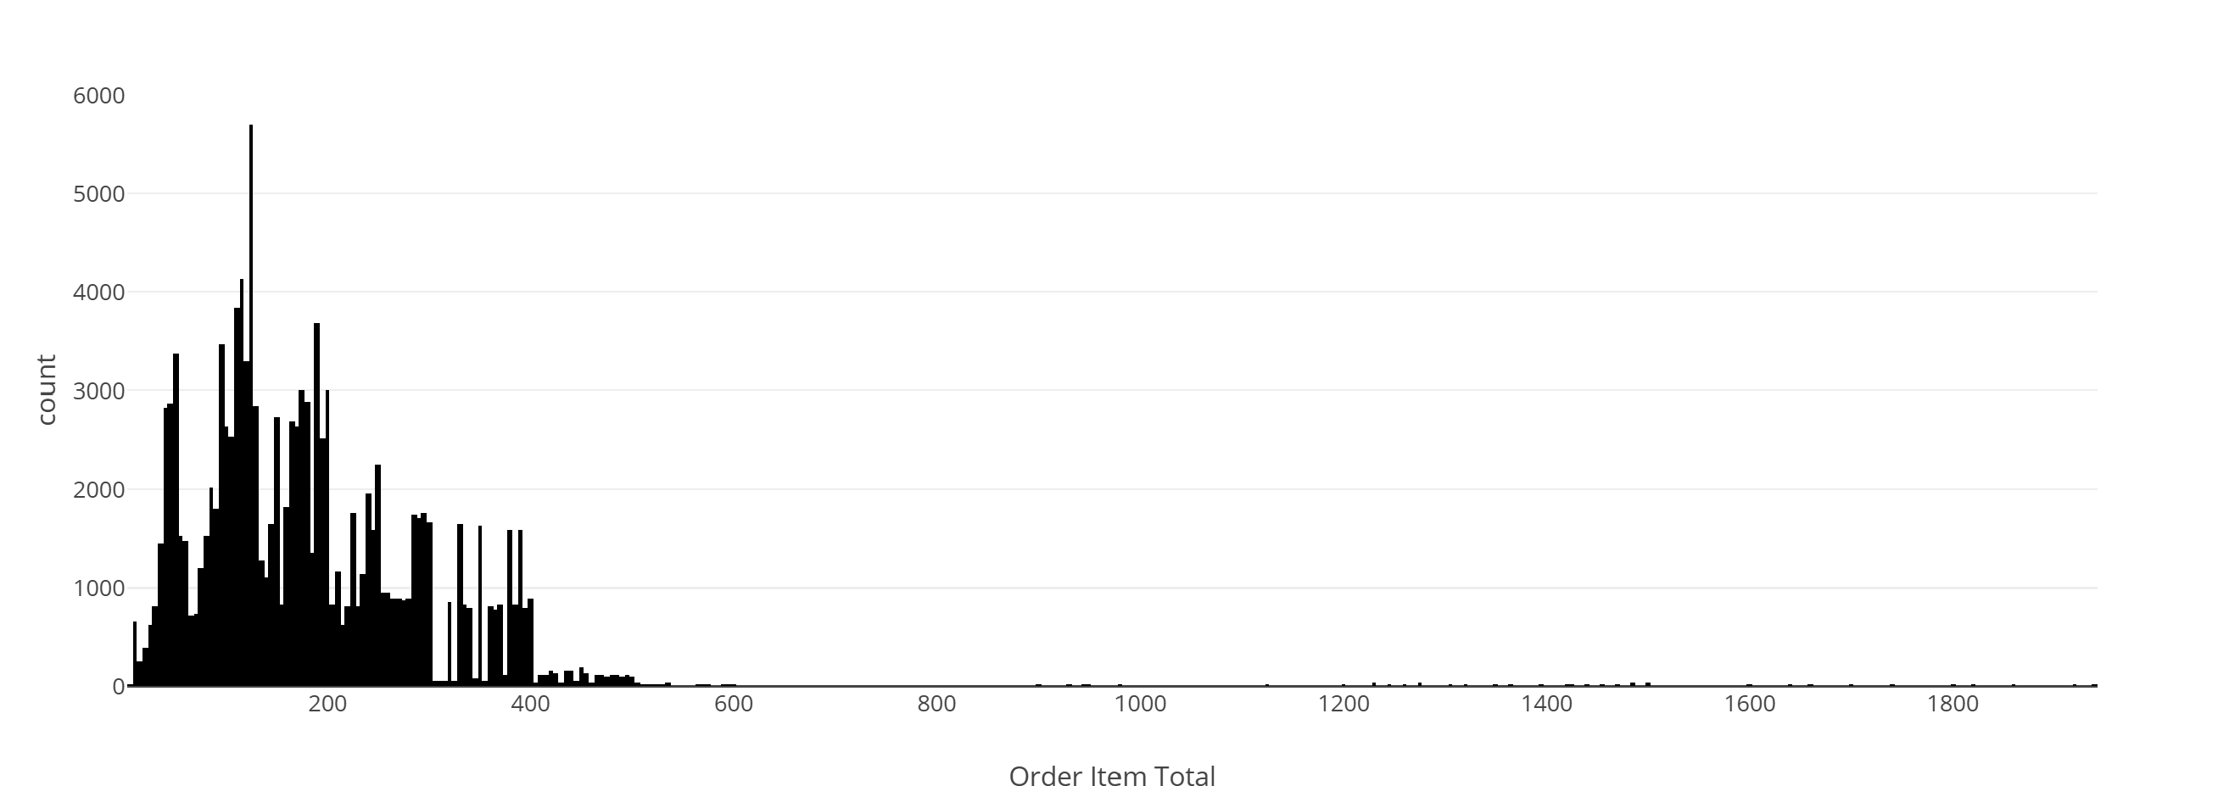
Step 7: Impute Missing Handled missing values in 'Order Item Total' using SimpleImputer (mean strategy)

Slide 49
step 8: Numerical Scaling Applied StandardScaler to scale 'Order Item Total' values step 9: Handle Class Imbalance Used SMOTE (Synthetic Minority Over-sampling Technique) to balance training data Step 10:Model Training Trained a Logistic Regression model using the balanced training set. step 11. Model Evaluation Predicted on the test set. Displayed performance using classification_report (Precision, Recall, F1-score, etc.)

Slide 50
7-Data Preprocessing using pipline (alternative option):- 1.Split Data into Input Features and Target Variable. 2.Split Data into Train and Test 3.Create Numerical & Categorical Pipelines. 4.Column Transformer to Assign columns to be processed. 5.Model Definition and Training. 6.Model Evaluation. 7.Cross Validation & Hyperparameter Tuning.

Slide 51
Data Preprocessing:- Step 1: Split Input Features and Target:- -Extract input X by dropping the Late_delivery_risk column. -Set target variable y = df['Late_delivery_risk’]. Step 2: Train/Test Split -Use train_test_split() with test_size=0.3 and random_state=40 to split data.

Slide 52
Step 3: Create Numerical & Categorical Pipelines. -Identify column types: Numerical (e.g. Order Profit Per Order) Nominal, Ordinal, Binary -Create preprocessing pipelines for each type: Numerical: Includes KNN imputation and 3 types of scalers. OneHot, Ordinal, Binary: With imputation and suitable encoders. Step 4: Column Transformer to Assign columns to be processed Use ColumnTransformer to apply the correct pipeline per feature type.

Slide 53
Step 5: Model Definition and Training:- -Define a pipeline. -preprocessing: to handle all feature transformations. -Classifier: logistic regression with max_iter=200 and random_state=42. -Split data again (test_size=0.2). -Fit the model on training data using .fit(x_train, y_train). -Predict on test set with .predict(x_test). -Reset Indexes for Consistency: Ensure all splits have consistent indexing using reset_index(). -Visualize Input Feature: Plot histogram of Order Profit Per Order from training set using px.histogram. -Handle Class Imbalance (SMOTE): Build a pipeline combining: Preprocessing → SMOTE oversampling → Logistic Regression. Train the pipeline using .fit().

Slide 54
Step 6: Model Evaluation Predict using .predict(). Evaluate performance using classification_report() and visualize metrics. Step 7: Cross Validation & Hyperparameter Tuning Apply 5-fold cross validation with accuracy scoring. Tune hyperparameters (C, penalty) using GridSearchCV.

